Slide 1
TEAM 1
CS 5500 – Apr 2017
Hari Vikas Rohit Kumar Yuzhi Ma

Slide 2
SUB TEAM
Front End Yuzhi Ma | Hari
Query Engine Rohit Kumar | Yuzhi Ma
User Interface Hari | Rohit Kumar
Notes:
Yuzhi Ma

Slide 3
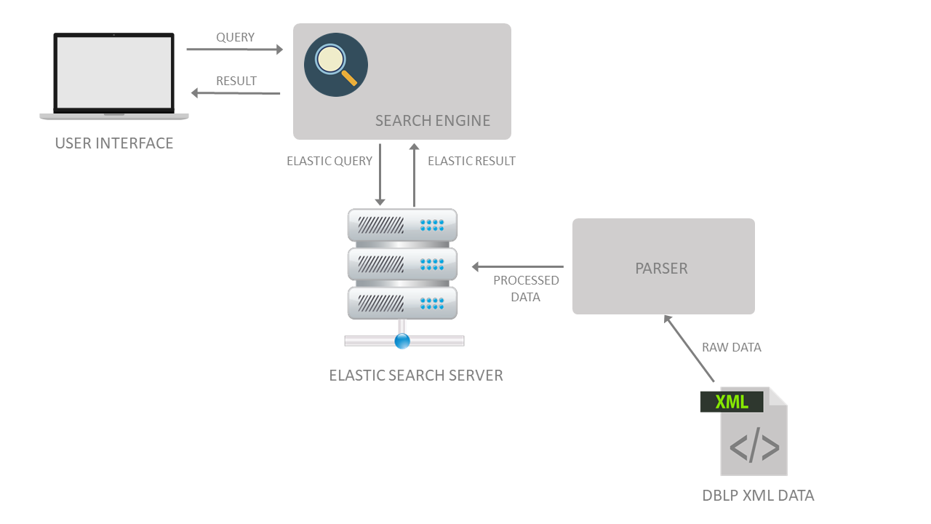
ARCHITECTURE

Slide 4
TOOLS
Junit for Unit testing
EclEmma for test coverage
SonarLint for code quality
AWS S3 for continuous deployment
JavaFX Maven for native packaging
JIRA for Agile management
Confluence for collaboration
Slack for communication
GitHub for version control
Jenkins for continues integration
Notes:
Yuzhi

Slide 5
PHASE 4
Patterns
Factory query engine ES client
Singleton ES connection, shortlist manager, UI Manager
Observer UI shortlist callback
Visitor UI preview history recorder
Code refactoring
Bulk Data indexing
Pre-loading of UI Layouts on separate thread
14 total use cases
Finished 13
Bugs Resolution:
7 categories (Solved all major issues raised as Homework 4)

Slide 6













OUR PROCESS
DOCUMENT IDEAS, DISCUSSION,
DECISIONS IN CONFLUENCE
TEAM MEETING
UNIT TESTS IN JUNIT
ISSUE CREATION IN JIRA
UPDATE IN ISSUSE
DEVELOPMENT IN ECLIPSE
PACKAGING IN AWS S3
BUILD IN JENKINS
COMMIT TO GITHUB
NOTIFICATION IN SLACK
Notes:
Rohit

Slide 7
CONTINUOUS INTEGRATION & DEPLOYMENT
Jenkins integration with Git
Automated build on Git commit
Jenkins integration with Slack
Automated notifications of build status, test results
Automated Packaging & Release
Automated package and push to AWS S3 on green Jenkins build

Slide 8
HIGHLIGHTS
ELASTIC SEARCH
full DBLP data
faster searching as each record is saved as an inverted index automatically
more relevant search results through hit score
RESTFUL endpoint for querying through simple key value pairs
search result boosting
easier integration with future platforms (Web, Native mobile, etc.)
NATIVE APPLICATION INSTALLERS
installers for Windows (.exe) and Mac (.dmg)
RESPONSIVE UI
simple responsive flat single frame UI

Slide 9
RESOURCES
Git Repo: https://github.ccs.neu.edu/CS5500-Spring2017/team1
Jenkins: http://ec2-54-201-177-192.us-west-2.compute.amazonaws.com:8080/job/MSD/
S3 Automated Package : http://rohitpagerank.s3-website-us-west-2.amazonaws.com
Sprint Retro : https://cs5500.ccs.neu.edu/confluence/display/TEAM1/2017-04-16+Retrospective?flashId=-2115002239

Slide 10
DEMO

